Slide 1
Software Quality Assurance Lecture 5
Presented by:
Dr. Yasmine Afify
yasmine.afify@cis.asu.edu.eg

Slide 2
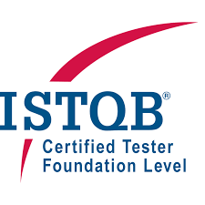
Reference
https://www.istqb.org/certifications/certified-tester-foundation-level
The ISTQB® Certified Tester Foundation Level (CTFL) certification provides essential testing knowledge that can be put to practical use and, very importantly, explains the terminology and concepts that are used worldwide in the testing domain. CTFL is relevant across software delivery approaches and practices including Waterfall, Agile, DevOps, and Continuous Delivery. CTFL certification is recognized as a prerequisite to all other ISTQB® certifications where Foundation Level is required.

Slide 3
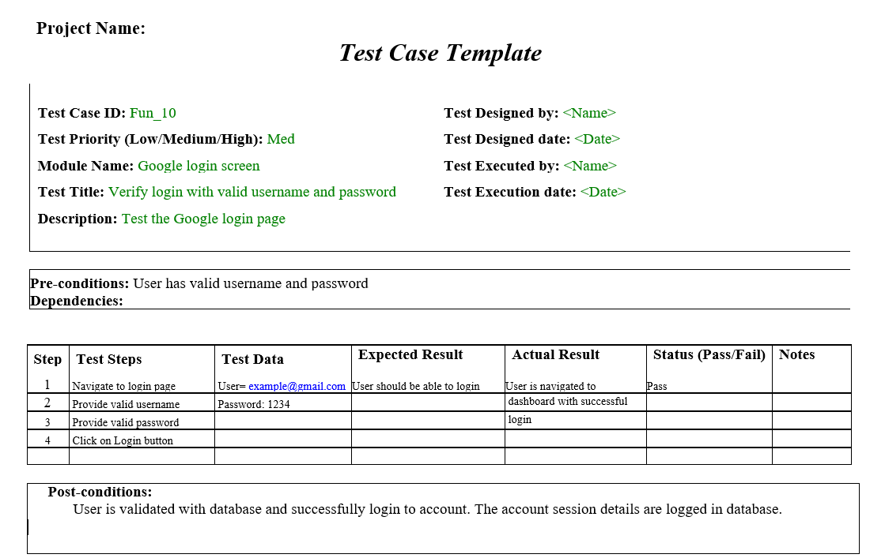
Test Case Template

Slide 4
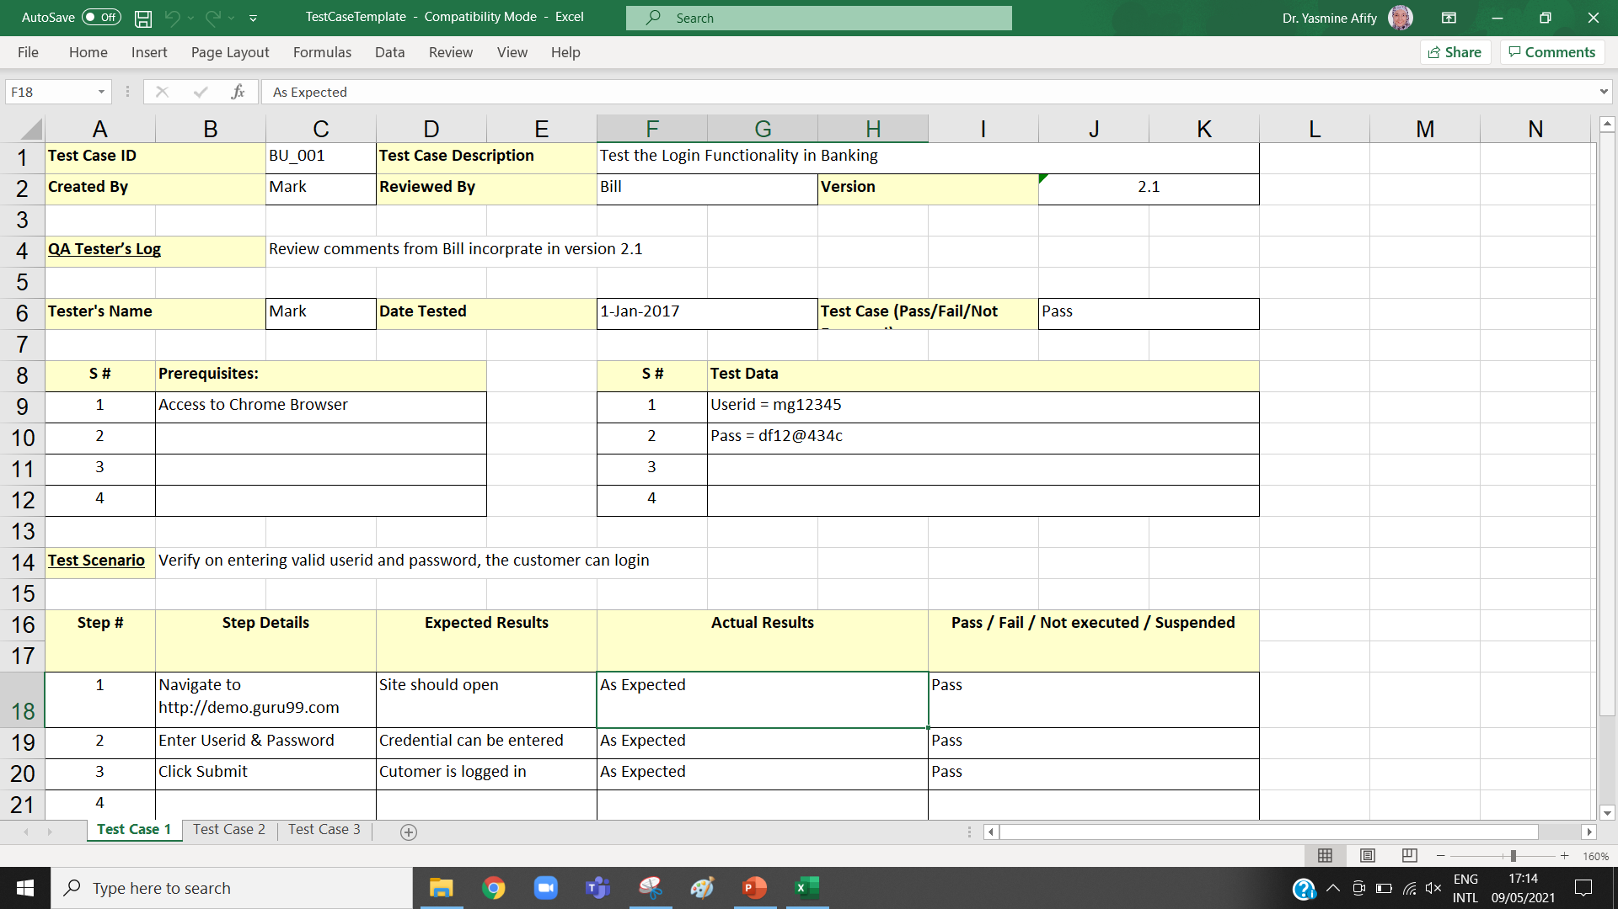
Test Case Template

Slide 5
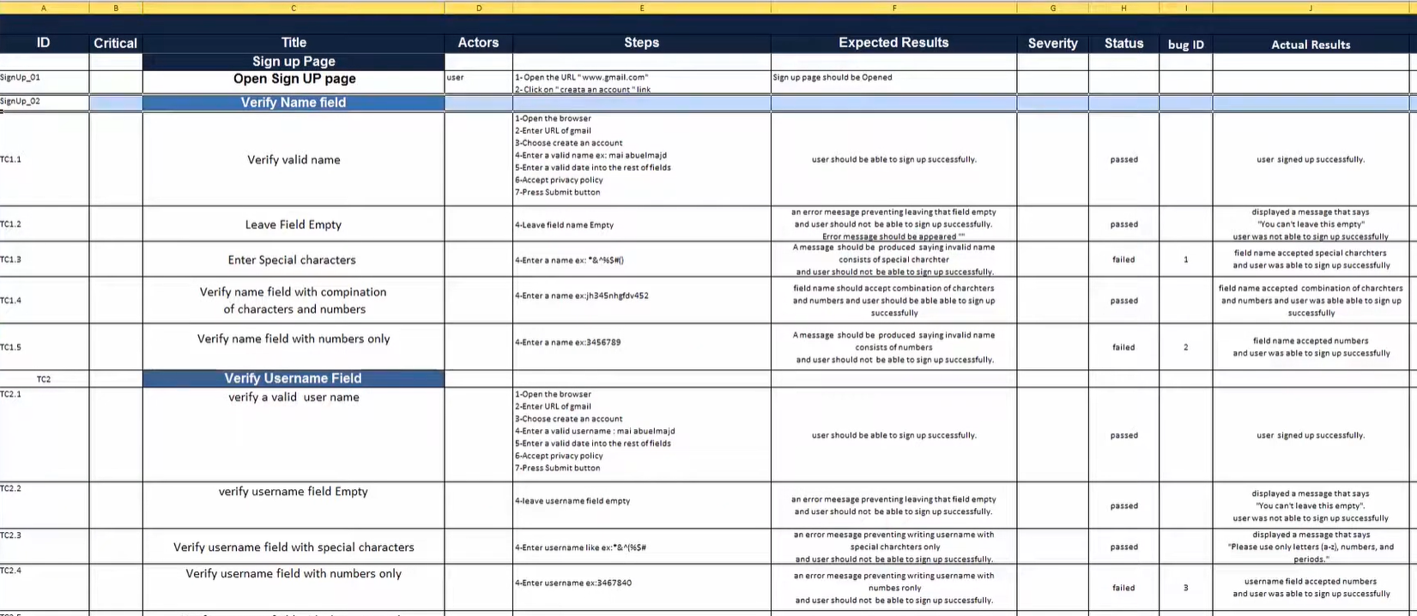
Example Test Cases for Sign-up Page

Slide 6
Defect report
After uncovering a defect (bug), testers generate formal defect report.
The purpose of a defect report is to state the problem as clearly as possible so that developers can replicate the defect easily and fix it.
Defect severity can be defined as the impact/effect of the bug on the application. It can be Showstopper/Critical/High/Medium/Low.
Defect priority can be defined as an impact of the bug on the customers business. Main focus on how soon/urgent the defect should be fixed. It gives the order in which a defect should be resolved by developers. It can be High/ Medium/Low.

Slide 7
Exercise: Specify scenario severity and priority
Submit button is not working on a login page and customers are unable to login to the application.
Crash in some functionality which is going to deliver after couple of releases.
Spelling mistake of a company name on homepage.
FAQ page takes a long time to load.
Company logo or tagline issues.
On a bank website, an error message pops up when a customer clicks on transfer money button.
Font family or font size or colour or spelling issue in the application or reports.
High Priority & High Severity
Low Priority & High Severity
High Priority & Low Severity
Low Priority & Low Severity
High Priority & Low Severity
High Priority & High Severity
Low Priority & Low Severity
Notes:
https://www.softwaretestingmaterial.com/what-is-the-difference-between-severity-and-priority-in-software-testing/

Slide 8
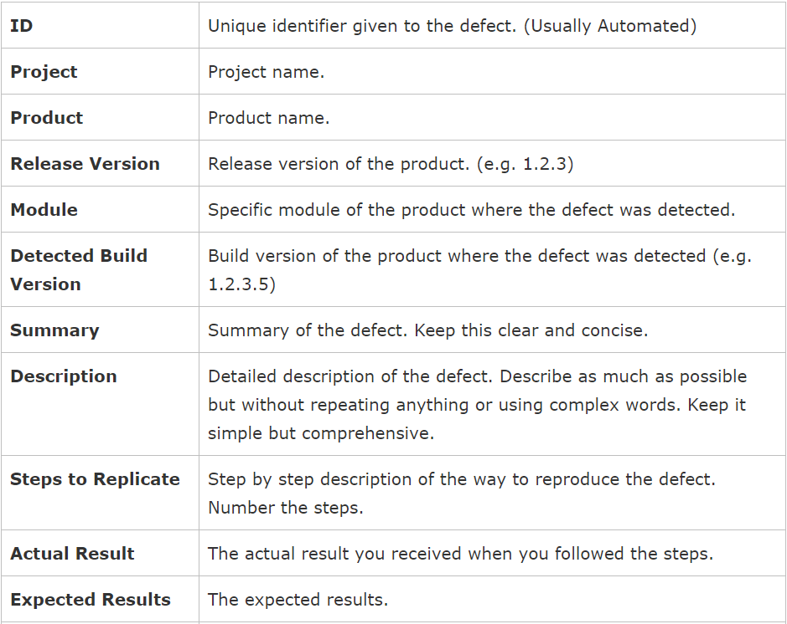
BUG Report

Slide 9
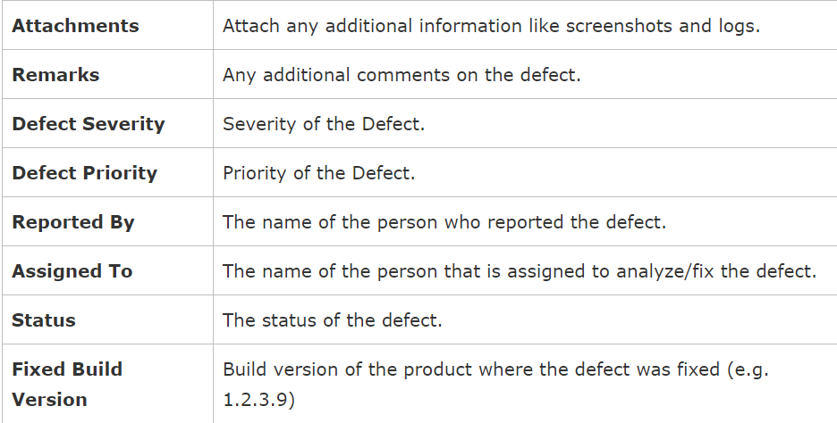
BUG Report
(cont.)

Slide 10
Defect Report
Details of the defect report may include:
• An identifier
• A title and a short summary of the defect being reported
• Date of the defect report, issuing organization, and author
• Identification of the test item and environment
• A description of the defect to enable reproduction and resolution, including logs, database dumps screenshots, or recordings (if found during test execution)
• Expected and actual results
• Severity of the defect
• Priority to fix
• Conclusions, recommendations and approvals
• Global issues, such as other areas that may be affected by a change resulting from the defect
• References, including the test case that revealed the problem

Slide 11
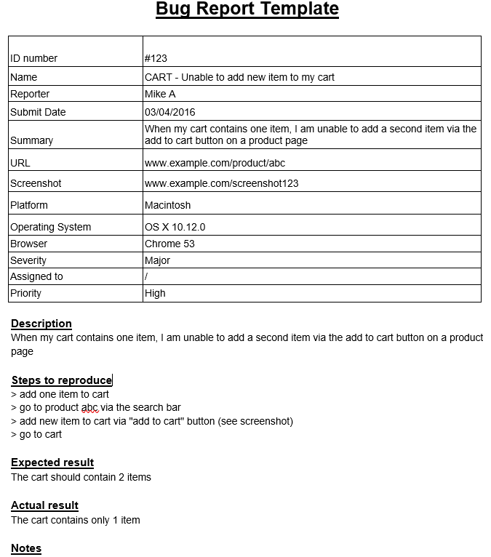

Slide 12
Test Procedure
Test Procedures Specification specifies the sequence/order of actions for a test, i.e. one or more Test Cases
Defining the test procedures requires carefully identifying constraints and dependencies that might influence the test execution sequence
Test procedures list any initial preconditions (e.g., loading of test data from a data repository) and any activities following execution (e.g., resetting the system status).
Notes:
From the Glossary:
test procedure specification: A document specifying a sequence of actions for the execution of a test*. Also known as test script or manual test script. [After IEEE 829]
*test: A set of one or more test cases [IEEE 829]

Slide 13
Test Execution Schedule
Once the various test cases and test procedures are assembled into test suites, the test suites can be arranged in a test execution schedule that defines the order in which they are to be run.
Test execution schedule should take into account factors such as prioritization, dependencies, and the most efficient sequence for executing the tests.
Ideally, test cases would be ordered to run based on their priority levels, usually by executing the test cases with the highest priority first. However, this practice may not work if the test cases have dependencies, or the features being tested have dependencies. If a test case with a higher priority is dependent on a test case with a lower priority, the lower priority test case must be executed first.
Notes:
From the Glossary:
test execution schedule: A scheme for the execution of test procedures. The test procedures are included in the test execution schedule in their context and in the order in which they are to be executed.

Slide 14
Test Conditions, Cases, Procedures and Schedule
What
How
How
When
Test
Procedure
Specification
Test
Execution
Schedule
Test
Condition
Test
Cases
Test
Cases
Manual Test Script
Test Procedure
Specifications
Sourced Documentation
or
Automated Test Script
Priority
Notes:
`This diagram summarises the major parts of test preparation and highlights their linkages

Slide 15
Requirements Traceability Matrix (RTM)
To implement effective test monitoring and control, it is important to establish and maintain traceability throughout the test process between elements of the test basis and the various test work products associated with that element
Requirements Traceability Matrix (RTM) connects requirements to test cases throughout the validation process
It shows the relationship between requirements and test cases to ask such question as:
Which test cases may be affected by change of requirement?
How much coverage of requirements has been achieved?
Are any requirements overly complex and need too many test cases?

Slide 16
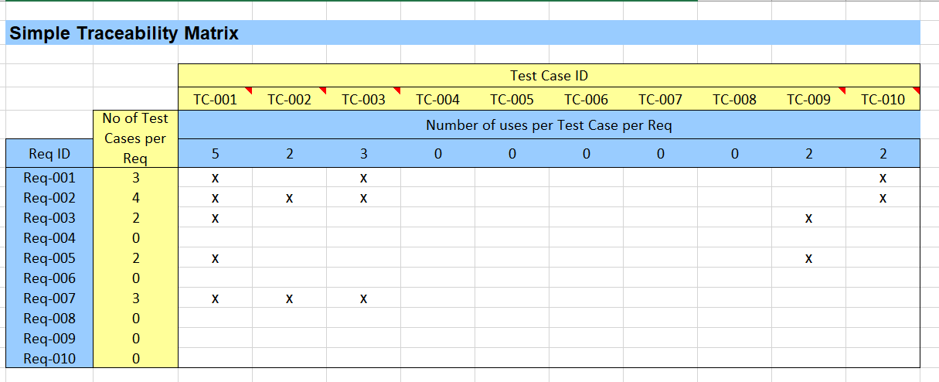
RTM

Slide 17
Importance of Traceability
Good traceability supports:
Analyzing the impact of changes
Making testing auditable
Meeting IT governance criteria
Improving the understandability of test progress reports and test summary reports to include the status of elements of the test basis (e.g., requirements that passed their tests/ requirements that failed their tests/requirements that have pending tests)

Slide 18
Test Closure Report
It is a report that is created once the testing phase is successfully completed by meeting exit criteria defined for the project.
It is a document that gives a summary of all the tests conducted.
It also gives a detailed analysis of the bugs removed and errors found.
It also presents the list of known issues.
It is created by test Lead, reviewed by various stake holders like test architect, test manager, business analyst, project manager and finally approved by clients.

Slide 19

Test case design techniques are used to pick the test cases in a systematic manner.
By using these techniques, we could save lots of testing time and get the good test coverage.

Slide 20
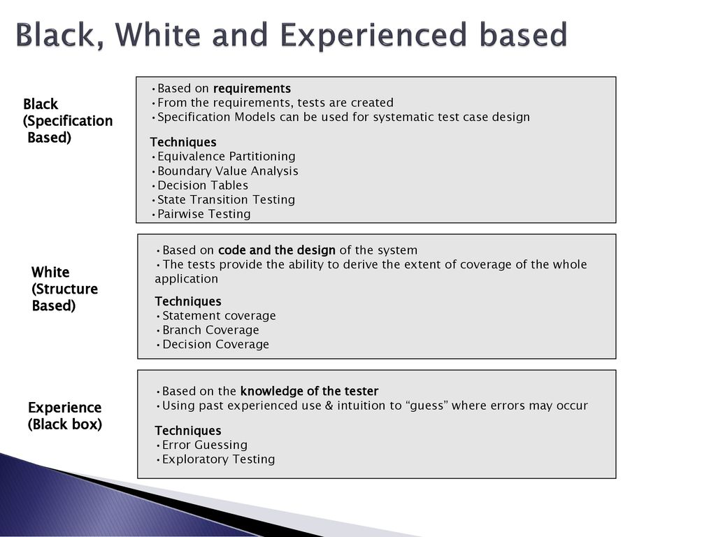

Slide 21
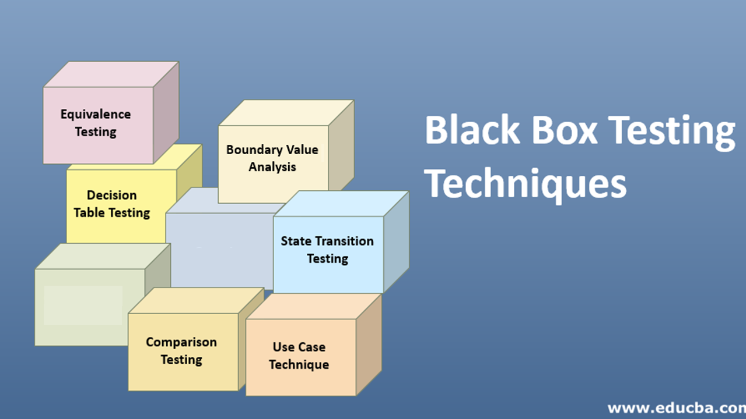

Slide 22
Black-box Test Case Design Techniques 1. Equivalence Partitioning (EP)
Equivalence partitioning divides data into partitions in such a way that all the members of a given partition are expected to be processed in the same way. There are equivalence partitions for both valid and invalid values.
Valid partitions include values that should be accepted.
Invalid partitions include values that should be rejected.
Partitions can be identified for any data element related to the test object, including inputs, outputs, and for interface parameters.
Each value must belong to one and only one equivalence partition.
When invalid equivalence partitions are used in test cases, they should be tested individually, i.e., not combined with other invalid equivalence partitions, to ensure that failures are not masked.

Slide 23
Black-box Testing Techniques 1. Equivalence Partitioning (EP)
To achieve 100% coverage, test cases must cover all identified partitions by using one value from each partition.
Requirement: value > = 1 and value <= 100
Invalid partition 1: 0, -1, -2 ,……
Valid partition : 1,..10,…45,….58,…71,….100
Invalid partition 2: 101, 102, …
Only three test cases are enough, one from each partition.

Slide 24
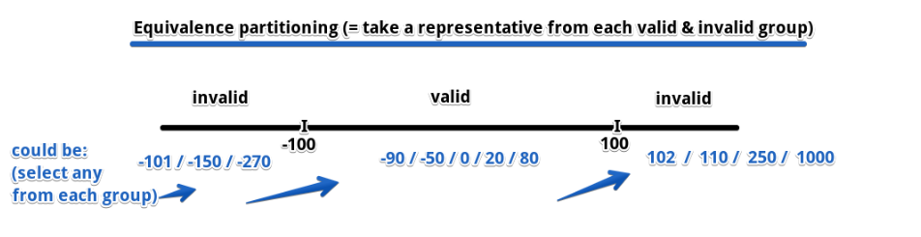
Specification-based (black-box) Equivalence Partitioning EP
A program which accepts an integer number in the range -100 to +100

Slide 25
Black-box Testing Techniques 2. Boundary value analysis (BVA)
BVA is an extension of equivalence partitioning that can ONLY be used when:
the partition is ordered
consisting of numeric or sequential data
Take the test conditions as partitions and design the test cases by getting boundary values of the partition.
Get both valid boundaries (from the valid partitions) and invalid boundaries (from the invalid partitions).
For example:
To test a field which accepts only an amount more than 10 and less than 20
We take the boundaries as 10-1, 10, 10+1, 20-1, 20, 20+1.
(Instead of using lots of test data, we just use 9, 10, 11, 19, 20 and 21)

Slide 26
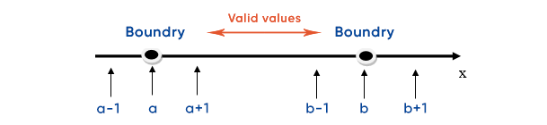
Specification-based (black-box) Boundary Value Analysis
6 test cases.
Can be applied on numeric values and dates.
Boolean present a problem for BVA.

Slide 27
Black Box Test Techniques
3. Decision Table Testing
Useful for testing the implementation of system requirements that specify how different combinations of conditions result in different outcomes.
Record complex business rules that a system must implement.
Steps: the tester identifies conditions (often inputs) and the resulting actions (often outputs) of the system. These form the rows of the table, usually with the conditions at the top and the actions at the bottom.
Each column corresponds to a decision rule that defines a unique combination of conditions which results in the execution of the actions associated with that rule.
The values of the conditions and actions are usually shown as Boolean values (true or false) or discrete values.
The common minimum coverage standard for decision table testing is to have at least one test case per decision rule in the table.

Slide 28
Black Box Test Techniques
Decision Table Testing
 | Test 1 | Test 2 | Test 3
Input 1 | T | T | F
Input 2 | T | T | F
Input 3 | T | DON’T CARE | F
Input 4 | T | F | T
Inputs / Actions
Output / Response
Response 1 | Y | Y | N
Response 2 | Y | N | Y
Response 3 | N | Y | N
The strength of Decision Table testing is that it creates combinations of conditions that might not otherwise have been exercised during testing

Slide 29
Black Box Test Techniques
Decision Table Example
 | Test 1 | Test 2 | Test 3
> 55 yrs old | F | T | T
Smoker | F | T | F
Exercises 3+ times a week | T | F | T
History of Heart Attacks | F | T | F
Insurance | Y | N | Y
Offer 10% Discount | N | N | Y
Offer 30% Discount | Y | N | N
What will be the outcome of the following Scenarios?
Joe is a 22-year-old, non-smoker, who goes to the gym 4 times / week and has no history of heart attacks in his family
Kevin is 62-year-old non-smoker who swims twice a week and plays tennis. He has no history of heart attacks in his family

Slide 30
Black-box Testing Techniques 4. State Transition
State transition testing allows the tester to view the software in terms of its states, transitions between states, the inputs or events that trigger state changes (transitions) and the resulting actions.
A state table shows the relationship between the states and inputs and can highlight possible transitions that are invalid.

Slide 31
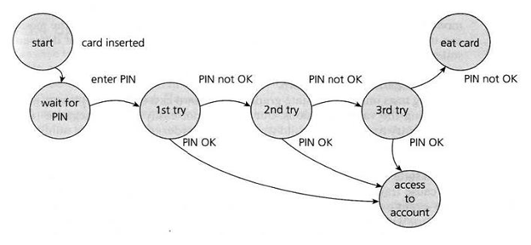
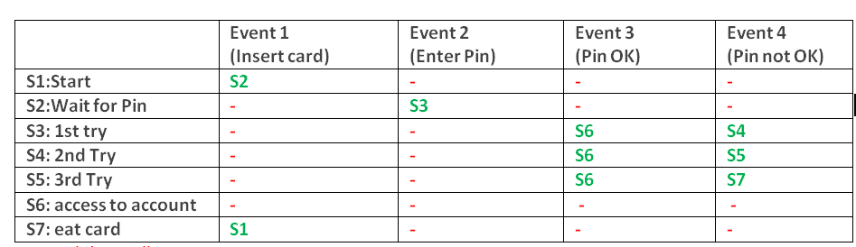
State transition testing
Invalid or Null Transitions are represented as ‘-‘ in red in the table above.

Slide 32
Black-box Testing Techniques 5. Use Case Testing
Test cases exercise defined basic, exceptional and error behaviours performed by the system under test in collaboration with actors.
Each use case has preconditions which need to be met for a use case to work successfully.
Each use case terminates with postconditions which are the observable results and final state of system after the use case has been completed.
Designing test cases from use cases may be combined with other specification-based test techniques (for details inside use case itself).
Use cases are very useful for designing acceptance tests with customer participation.

Slide 33
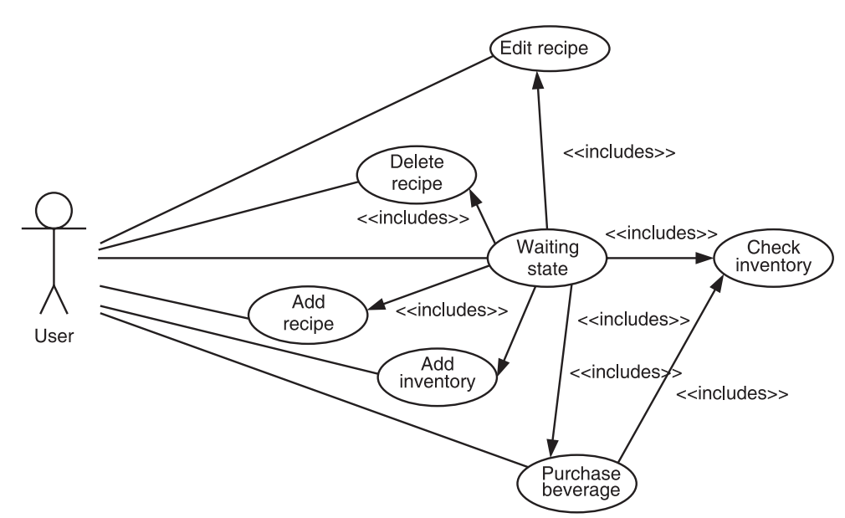
Use case diagram for coffee maker

Slide 34
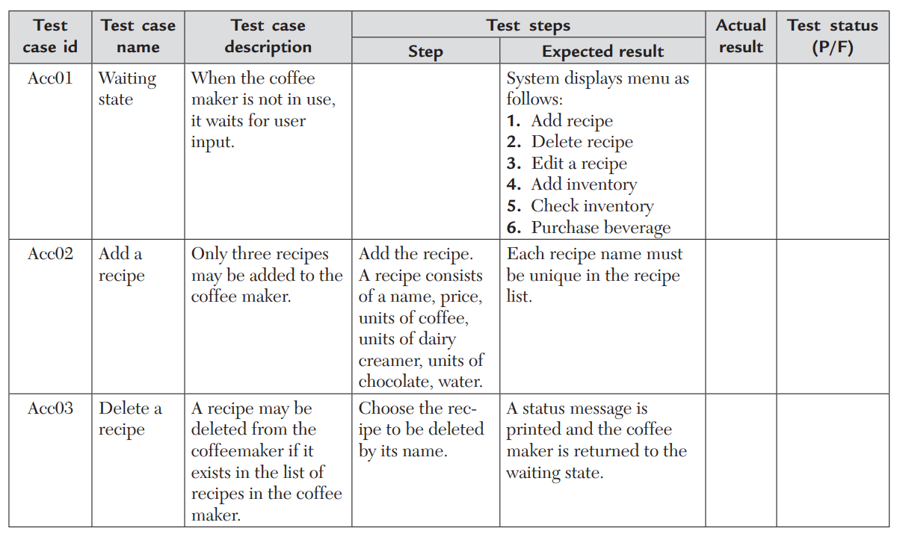
Acceptance Test Cases

Slide 35
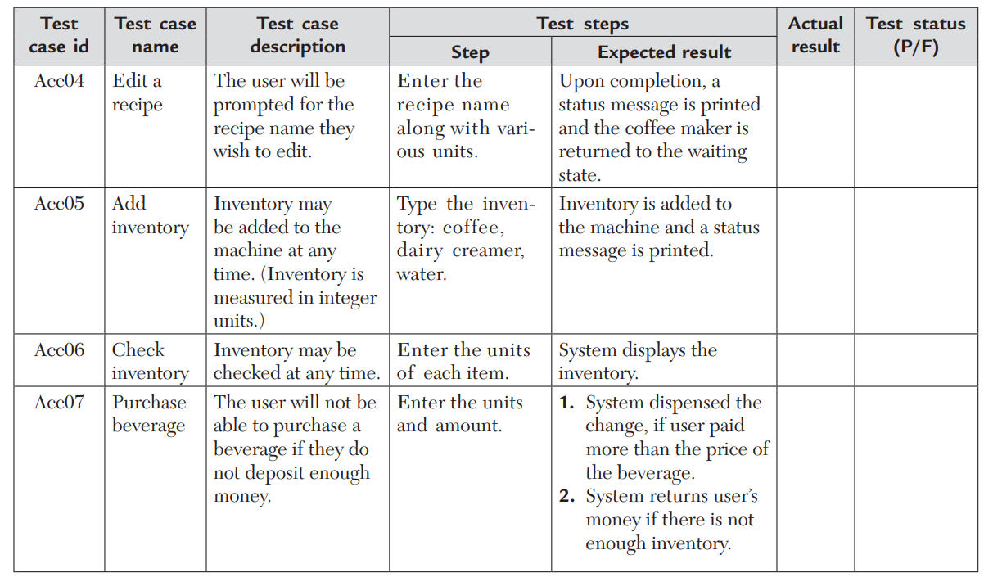
Acceptance Test Cases
Notes:
p151

Slide 36
Advantages Of Black-box Testing
Tests are performed adopting the user’s point of view. So, there is higher chance of meeting customer’s expectations.
There is unbiased testing as both the tester and the developer work independently.
It is suitable for the testing of very large systems.
There is no need for any technical knowledge or language specification.
Test cases can be designed as soon as the requirements are finalized.

Slide 37
Early Black Box Testing
Program code is not necessary
Only a description of intended behavior is needed
Even incomplete and informal specifications can be used
Although precise, complete specifications lead to better test suites
Early test design has side benefits
Often reveals ambiguities and inconsistency in specs
Useful for assessing testability
Thus, improving test schedule and budget by improving spec
Useful explanation of specification

Slide 38
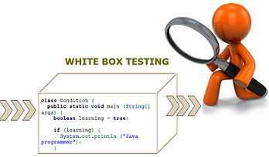
2. Structure-based (White-box) Techniques
White-box test techniques can be used at ALL test levels, but the statement and decision testing are most commonly used at the component test level.
Notes:
https://professionalqa.com/white-box-testing

Slide 39
Structure-based (White-box) 1. Statement Testing & Coverage
Statement testing exercises the executable statements in the code. Coverage is measured as the number of executable statements executed by the tests divided by the total number of executable statements in the test object, normally expressed as a percentage.
To calculate statement coverage, find out the shortest number of paths following which all the nodes will be covered.

Slide 40
Structure-based (White-box) 2. Decision Testing & Coverage
Decision testing exercises the decisions in the code and tests the code that is executed based on all decision outcomes.
To do this, the test cases follow the control flows that occur from a decision point (e.g., for an IF statement, one for the true outcome and one for the false outcome; for a CASE statement, test cases would be required for all the possible outcomes, including the default outcome).
Coverage is measured as the number of decision outcomes executed by the tests divided by the total number of decision outcomes in the test object, normally expressed as a percentage.
When 100% decision coverage is achieved, it executes ALL decision outcomes, which includes testing the true outcome and also the false outcome, even when there is no explicit false statement (e.g., in the case of an IF statement without an else in the code).

Slide 41
Decision Testing & Coverage
.
To calculate decision coverage, find out the minimum number of paths which will ensure covering of all the edges. In this case, there is no single path will ensure coverage of all the edges at one go.
Decision coverage is stronger than statement coverage; 100% decision coverage guarantees 100% statement coverage, but not vice versa.

Slide 42
3. Experience-based Techniques
Experience-based testing is where tests are derived from the tester’s skill and insight and their experience with similar applications and technologies.
When used to supplement/augment systematic techniques, these techniques can be useful in identifying special tests not easily captured by formal techniques.
However, this technique may yield widely varying degrees of effectiveness, depending on the testers’ experience.

Slide 43
3. Experience-based Techniques 3.1 Error Guessing
A commonly used experience-based technique is error guessing.
Generally, testers anticipate defects based on experience.
A structured approach to the error guessing technique is to enumerate a list of possible defects and to design tests that attack these defects (called fault attack).

Slide 44
3. Experience-based Techniques 3.2 Exploratory Testing
Informal (not pre-defined) tests are designed, executed, logged, and evaluated dynamically during test execution. The test results are documented and used to learn more about the component or system, and to create tests for the areas that may need more testing.
Exploratory testing is sometimes conducted using session-based testing to structure the activity. In session-based testing, exploratory testing is conducted within a defined time-box, based on a test charter containing test objectives.
In exploratory testing, test design and test execution happen at the same time but are guided by a documented test charter that includes actors, test conditions, test data, etc.
Most useful where:
there are few or inadequate specifications
severe time pressure
used to augment or complement other formal testing types.

Slide 45
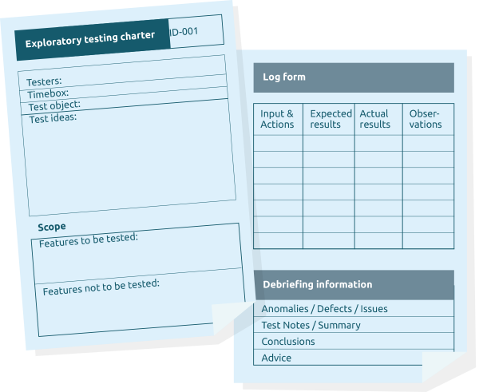

Slide 46
3. Experience-based Testing 3.3 Checklist-based Testing
In checklist-based testing, testers design, implement, and execute tests to cover test conditions found in a checklist.
As part of analysis, testers create a new checklist or expand an existing checklist, or use an existing checklist without modification.
Such checklists can be built based on experience, knowledge about what is important for the user, or an understanding of why and how software fails.
Checklists can be created to support various test types, including functional and non-functional testing.

Slide 47
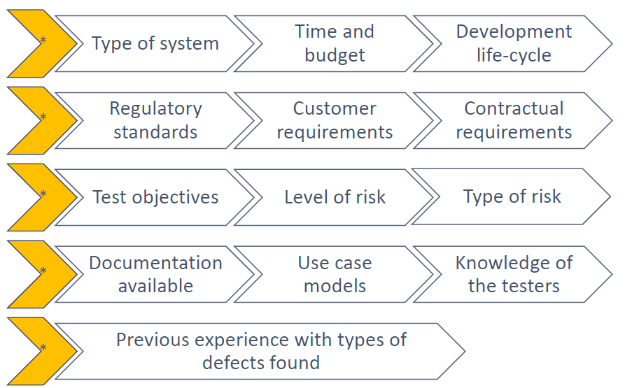
Choosing test techniques
The choice of which test techniques to use depends on a number of factors, including:

Slide 48
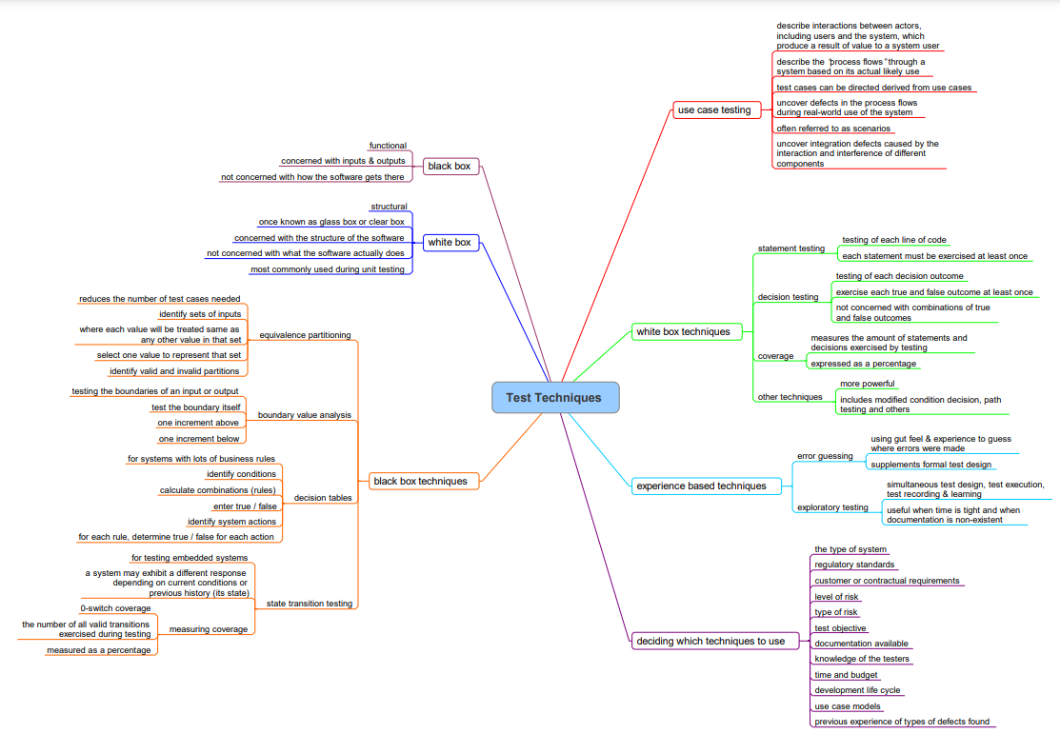

Slide 49


Midterm Exam and Quiz
Lectures 1 to 4
Attend in your time slot according to the announced schedule
Write your name, ID, department and level on the exam paper
TWICE (on each side of the paper)
Answer both assessments in the exam paper
Sign your name in the attendance sheet once
No tolerance for cheating

Slide 50


